Slide 1


Drinkin’ Cold Coffee
-or-
How to use Java Objects from ColdFusion.

Slide 2
What are you going to learn?
Why you might want to use Java objects from ColdFusion.
How to instantiate Java objects from ColdFusion MX.
How to call the constructors of Java objects.
How to call methods on Java objects.
The advantages of using Java (as opposed to CFX tags, etc)
Potential problems and their solutions.

Slide 3
What can you do with Java?
Use strong encryption.
Manipulate Images.
Edit audio clips.
Zip and Unzip files.
Create network socket connections.
Low level programming.
Almost anything you can do with the Java language.

Slide 4
Why do you care about Java?
ColdFusion is written in Java
Macromedia has been pushing CF deployment on J2EE servers
  In short, an easy way to write J2EE applications.
In short, ColdFusion is a friendly version of Java.
ColdFusion provides an easy way to use Java without requiring extensive knowledge of Java.
Blackstone may deploy ColdFusion applications as WAR files on J2EE.
Notes:
You might wonder what relevance Java has to you as a ColdFusion developer.
You know that ColdFusion is written in Java
Macromedia has recently been pushing ColdFusion as an Enterprise Java platform.
Let’s face it, ColdFusion is a high level version of Java.
You can deploy on J2EE servers
Code is Compiled to Java byte code
ColdFusion is written in Java
“It makes it all work”
You don’t really need to know Java to use Java Objects in ColdFusion
Java Objects provide a lot of power.

Slide 5
Where to find the Java Docs
http://java.sun.com/j2se/1.4.2/docs/api/index.html
The hardest part of using Java is learning how to read the documentation.
Notes:
When on this slide be sure to discuss how to read the Java Docs. IE:
All packages are listed in the top left frame (also on home page in big frame)
All classes are listed to the left
Documentation is in the main frame
Go into the java.awt.image.BufferedImage and show the various parts. IE:
Fields
Their purpose in BufferedImage is of defining types of images.
In java.util.zip.ZipFile is for various constants of the object
Constructors
Used to initialize the objects. Must be called before using the object. (Some exceptions which you’ll learn though working with it)
Methods
Used to perform actions
IE: get the width of an image or list the contents of a zip file

Slide 6
How to invoke Java objects
CreateObject()
  <cfset myZip = CreateObject("Java", "java.util.zip.ZipFile") />
<cfobject>
  <cfobject
  type="Java"
  action="Create"
  class="java.util.zip.ZipFile"
  name="myZip" />
Notes:
I prefer createObject because it’s less verbose than cfobject.
They do the same thing.

Slide 7
Typing in Java vs. ColdFusion
Java is a strongly typed language
  This means the language always knows what type a variable is
ColdFusion is a typeless language.
  This means any variable can be a string, integer, query, whatever.
Because ColdFusion is typeless, CF has to guess what type of data you are passing into Java object methods.
If ColdFusion passes an incorrect type into a Java method you will get errors.

Slide 8
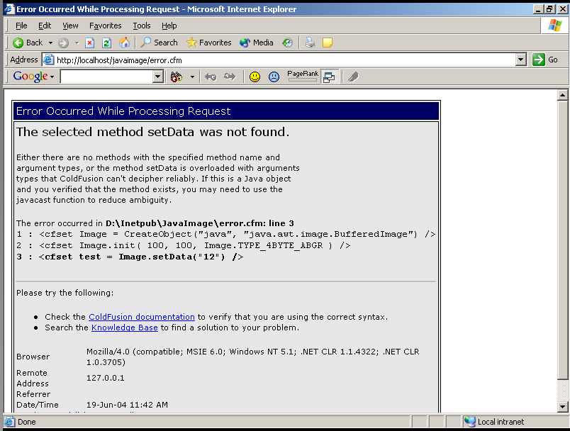
An example typing error

Slide 9
Use JavaCast() to type CF variables
You can use JavaCast() to type data being passed into Java methods.
Casts data from ColdFusion to Java.
Intended for calling overloaded Java Methods.
Syntax:
JavaCast(type, variable)

Slide 10
How to init Java objects
Most Java objects require that you call a constructor to configure objects for use.
Use “.init()” to call constructors on Java objects.

Slide 11
Calling Object Constructors
To instantiate a Java zipFile object you have to call one of three constructors
  http://java.sun.com/j2se/1.4.2/docs/api/java/util/zip/ZipFile.html
Example:
  <cfset pathToZip = "c:\example.zip" />
  <!--- create the zipFile object --->
  <cfset myZip = CreateObject("Java", "java.util.zip.ZipFile") />
  <!--- call a constructor on the zipFile object --->
  <cfset myZip.init(JavaCast("string",pathToZip)) />

Slide 12
What happens when you don’t init an object?
<cfset FileInputStream = CreateObject("Java", "java.io.FileInputStream") />
<cfset FileInputStream.read() />

Slide 13
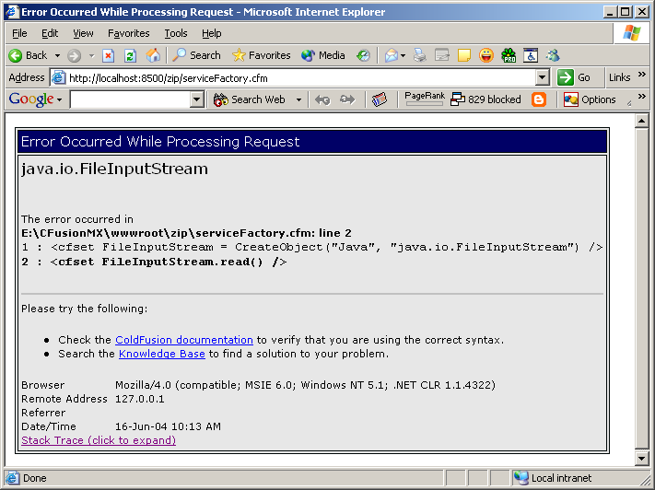
What happens when you don’t init an object?

Slide 14
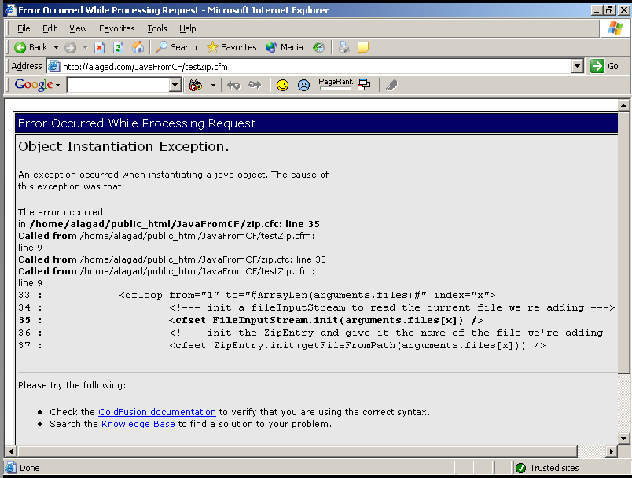
What happens when there are other problems initing your object?

Slide 15
Calling Java Object methods
We can call methods of the myZip object to perform various actions.
  http://java.sun.com/j2se/1.4.2/docs/api/java/util/zip/ZipFile.html#getInputStream(java.util.zip.ZipEntry)
For instance:
  <cfoutput>
  The Zip File "#myZip.getName()#" contains #myZip.size()# files.
  </cfoutput>
Notes:
Once we have an initialized object we can call methods on that object.
For instance, the zipFile object has a set of methods (as defined in the documentation) which we can call.

Slide 16
Another (more complex) example
Get a list of files in the myZip object
<!--- returns an Enumeration object --->
<cfset zipFiles = myZip.entries() />
<!--- loop while there are elements in the Enumeration --->
<cfloop condition="#zipFiles.hasMoreElements()#">
<cfset myZipEntry = zipFiles.nextElement() />
<cfoutput>
#myZipEntry.getName()#
(#myZipEntry.getSize()# Bytes)<br>
</cfoutput>
</cfloop>
Notes:
Go to the java docs and pull up zip.
Show the entries() method returns an enumeration object
Show how the zipFiles Enumeration contains an “array” of zipEntry objects
Show the methods of the zipEntry object and how I called them.

Slide 17
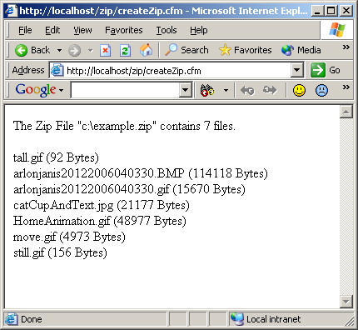
Results so far
<cfset pathToZip = "c:\example.zip" />
<cfset myZip = CreateObject("Java", "java.util.zip.ZipFile") />
<cfset myZip.init(JavaCast("string", pathToZip)) />
<cfoutput>
<p>The Zip File "#myZip.getName()#" contains #myZip.size()# files.</p>
</cfoutput>
<!--- returns an Enumeration object --->
<cfset zipFiles = myZip.entries() />
<!-- loop while there are elements in the Enumeration --->
<cfloop condition="#zipFiles.hasMoreElements()#">
<cfset myZipEntry = zipFiles.nextElement() />
<cfoutput>
#myZipEntry.getName()# (#myZipEntry.getSize()# Bytes)<br>
</cfoutput>
</cfloop>

Slide 18
Using <cfdump> to get more information on Java Objects
You can use <cfdump> on any ColdFusion variable.
If the variable a Java object you get:
  The object type name
  The object’s methods
  The object’s properties
Example:
  <cfset FileInputStream = CreateObject("Java", "java.io.FileInputStream") />
  <cfset FileInputStream.init("c:\Collin 4 copy.jpg") />
  <cfdump var="#FileInputStream#">

Slide 19
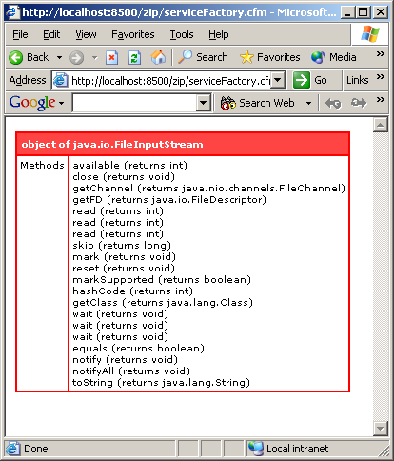
Results from the dump
Can be helpful in figuring out what an object is and what methods it provides.
Helps support the Java documentation.
Another dump example: http://alagad.com/JavaFromCF/cfdump.cfm

Slide 20
Wrapping Java in CFCs
You can use CFCs to wrap Java objects.
Provides easier access to complex Java objects.
Extremely reusable and cross platform.

Slide 21
Let’s look at a simple Zip CFC
Create Zip files
  Add files to Zip files
Return a query of all the files in a Zip file
  Name
  If the entry is a directory
  Uncompressed size
  Compressed size
Extract files from the zip

Slide 22
Alagad Image Component
A good example of wrapping Java in CFCs.
100% native ColdFusion Component (CFC) used to create and manipulate image files by invoking and calling methods on Java objects.
Over 60 methods for working with Images.
Platform independent.
Makes lots of use of Java from within ColdFusion.
http://alagad.com/index.cfm/name-aic

Slide 23
Advantages of using Java in ColdFusion
Cross Platform
  Write code on any platform and deploy to any platform.
The power of Java at your fingertips.
It’s Free!
It’s not CFX!
Notes:
I might want to explain how CFX tags have been problematic for me in the past.

Slide 24
What did you learn?
Why you might want to use Java objects from ColdFusion.
How to instantiate Java objects from ColdFusion MX.
How to call the constructors of Java objects.
How to call methods on Java objects.
The advantages of using Java (as opposed to CFX tags, etc)
Potential problems and their solutions.
That you really need to by the Alagad Image Component.

